Slide 1
A THRIVING COMMUNITY STARTS WITH YOU
Notes:
Thank you for having United Way here today!
[Introduce Yourself]
At United Way, we believe a thriving Chattanooga starts with YOU
Our work would not be possible without you, our generous donors, volunteers, and advocates
We've been part of this community for over 100 years now
At our core, we connect people and resources to build a stronger community
Because we believe a more connected community changes everything
As an organization who cares deeply for their community, you also understand the importance of this work
The importance of supporting communities where you live and work every day
This is not new to you – you are the change-makers working alongside us
Today, I want to talk about how we can work together to ensure every child can thrive
And working families can break the cycle of financial hardship

Slide 2
Meet Sarah
A story from our 211 helpline
Sarah is a small business owner and single mother to her two-year-old daughter. When she was diagnosed with breast cancer, her income plummeted.
United Way’s 211 helpline stepped in to cover her rent, so Sarah and her daughter were able to stay in their home.
Your support allows us to answer over 73,000 211 requests every year to help more neighbors like Sarah.
Notes:
You might be asking – what does United Way do in my community
The best way to answer that is by rooting our work in real stories from our neighbors
Some of you in this room might have your own stories as well
To protect our neighbor's privacy, identities have been changed in these stories
Meet Sarah
A story from our 211 helpline and providing direct assistance
211 is a free and confidential helpline connecting neighbors across the Tennessee Valley to critical resources, and providing direct emergency assistance when they need it most
Our local 211 navigators can help you find resources across numerous categories
Including food, housing, employment, education, health services, and more.
Meet Sarah
Sarah is a small business owner and single mother to her two-year-old daughter. In 2023, she was diagnosed with breast cancer, which resulted in a drastic decline in her income due to frequent doctor appointments and staffing needs required to keep her business running.
During this challenging time, she turned to United Way’s 211 helpline for assistance in covering her rent, ensuring that she and her daughter could remain in their home.
Your donation allows us to answer more than 73,000 211 requests and provide over $800,000 in direct emergency assistance to neighbors in need each year.

Slide 3
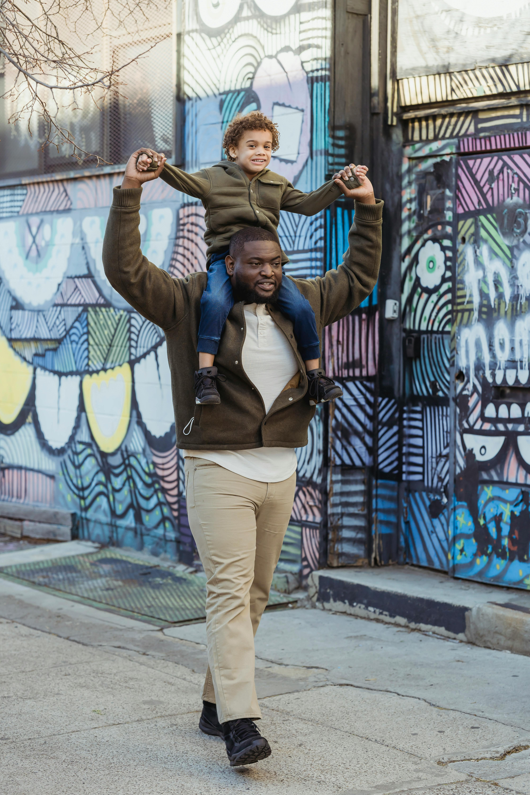
Meet Marcus
A story from our United for Working Families initiative
Marcus was at risk of having to leave his long-time employer due to the lack of affordable childcare.
United Way stepped in to connect him to a childcare stipend so Marcus could keep his job and provide a stable home for his young family.
Your support allows us to empower local employers to offer family-friendly policies like flexibility and childcare support.
Notes:
Meet Marcus
A story from our United for Working Families initiative
Marcus has been a long-time employee at an organization in town who is committed to fostering a family-friendly culture. The lack of affordable childcare options left Marcus with very little options for his growing, young family. He was at risk of having to leave his job when his supervisor called United Way.
We were able to connect Marcus to a childcare stipend so he could afford childcare for his youngest and he was able to stay employed and provide a stable home for this family.
The United for Working Families initiative is more than just a one-time solution. Marcus’s employer is now at the table, helping to shape the future of our workplace by providing family-friendly benefits that extend beyond just one-time help.
Proving that family-friendly is business-friendly is our United for Working Families initiative at work.
We’re guiding local businesses and organizations to implement family-friendly policies like flexibility and childcare support, so neighbors like Marcus can find a job and stay employed, raise a healthy and happy family, and build upward economic mobility.
When families thrive, communities thrive.

Slide 4
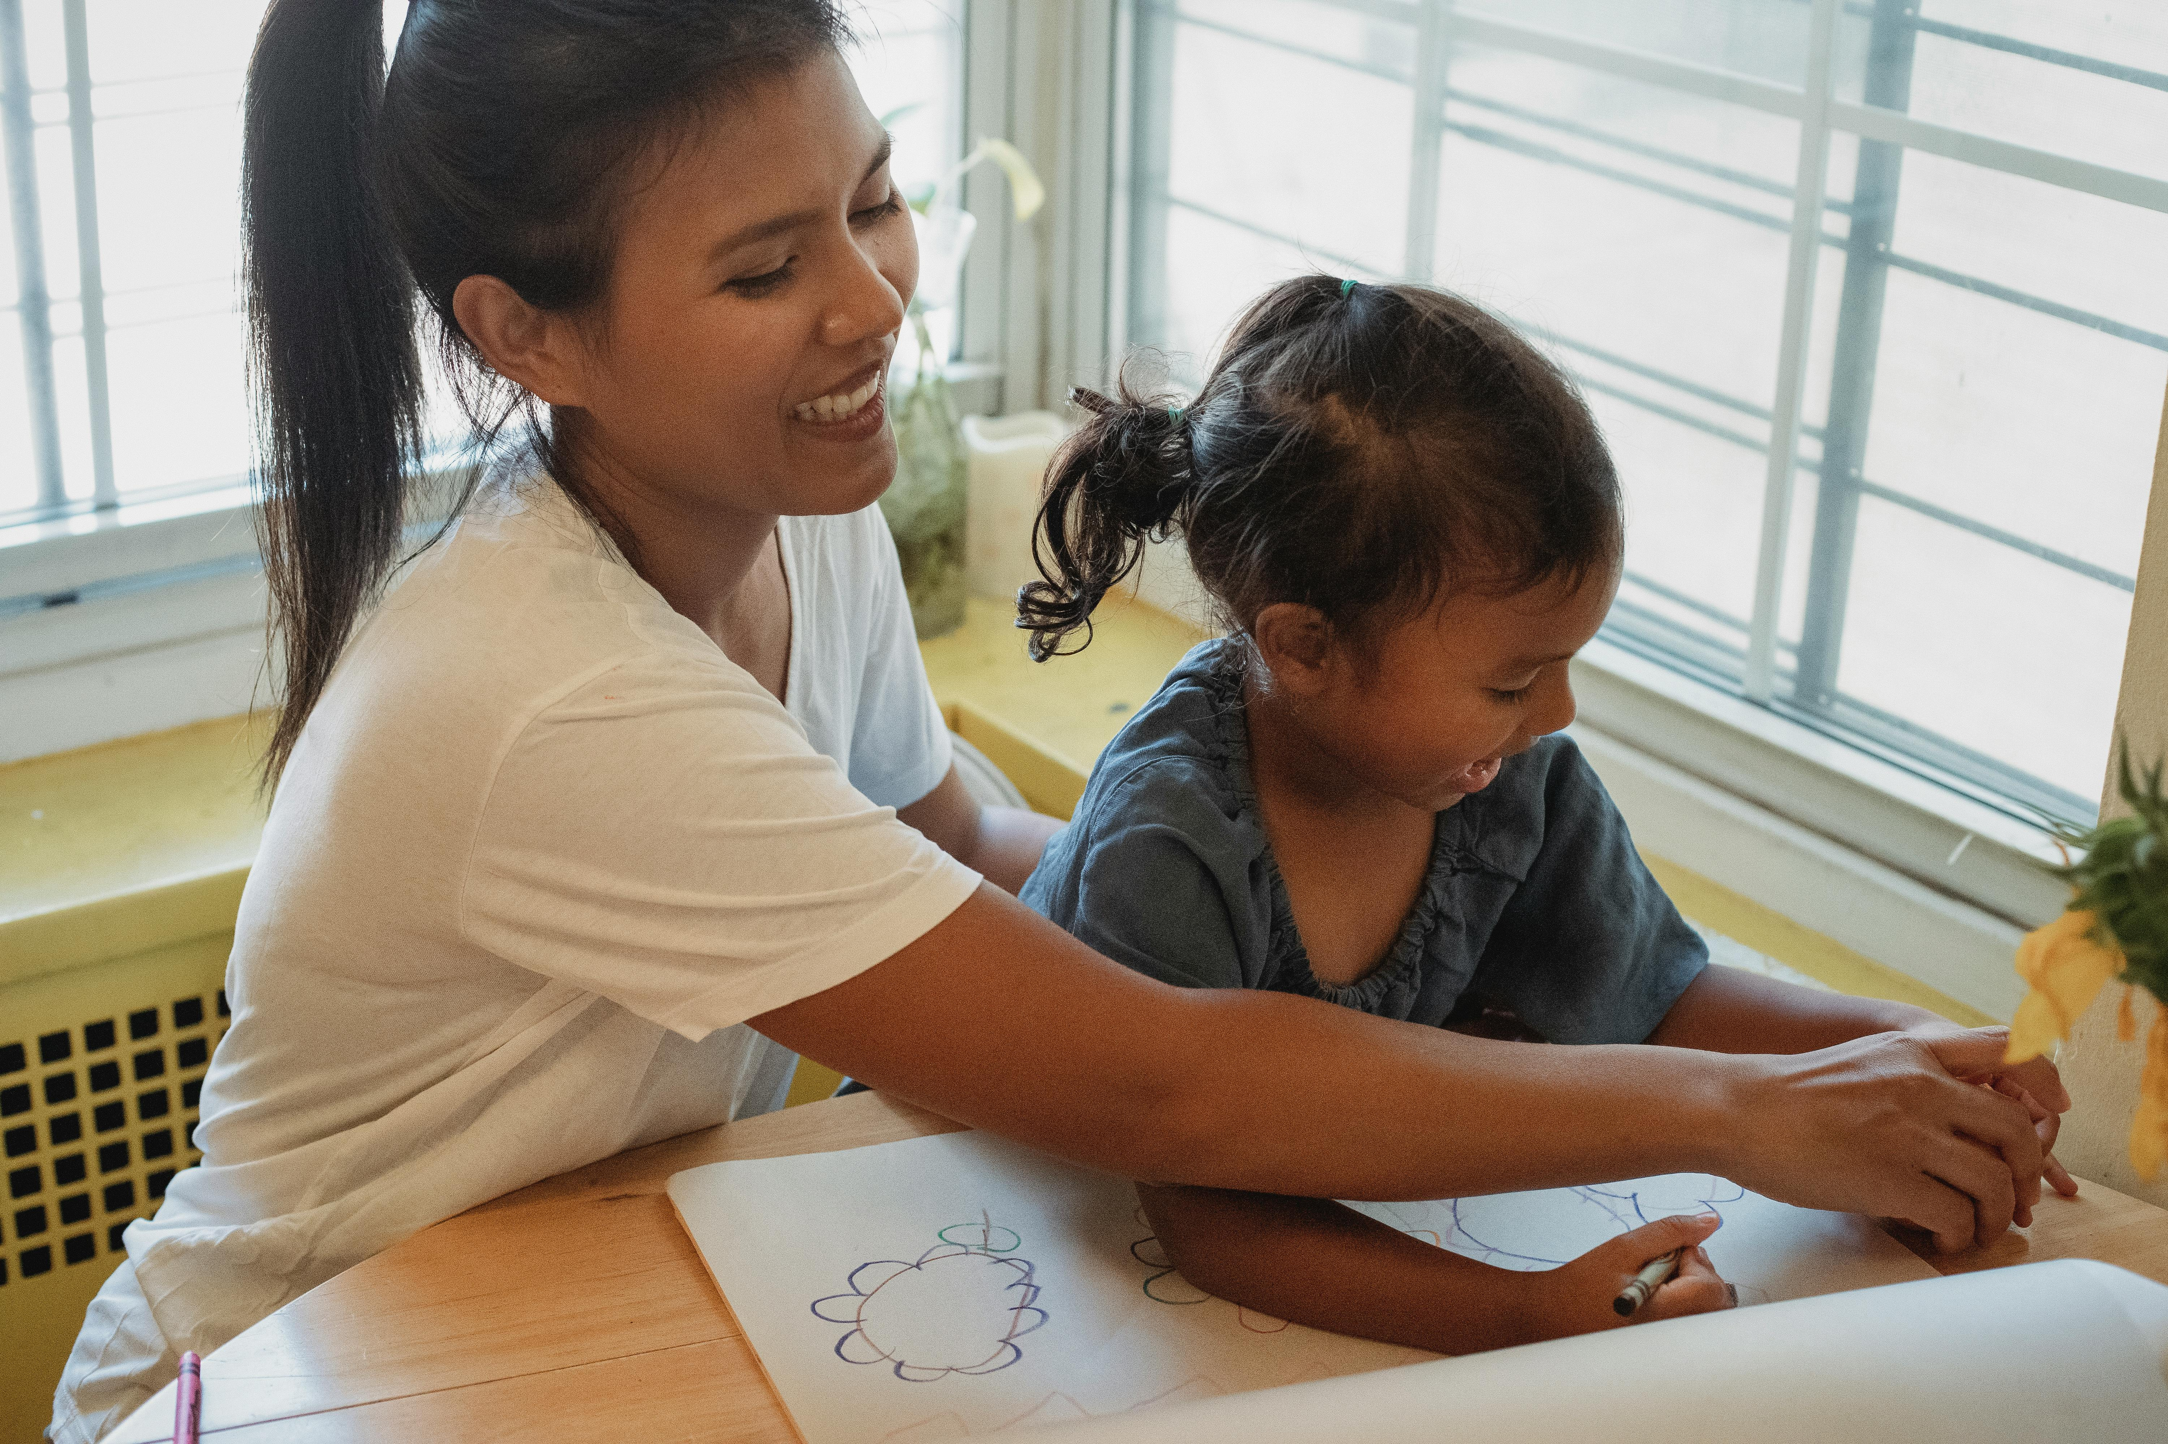
Meet Tasha
A story about how we support and invest in our local nonprofits
Tasha is a single mother who was reduced to part-time status and facing eviction when she called United Way’s 211 helpline.
We connected her to the critical resources she needed and helped enroll her in the Generation Stronger program, run by a local nonprofit we help fund through our grant model.
Your support allows us to fund over 70 nonprofits with over $4M every year to help more neighbors like Tasha.
Notes:
Meet Tasha
A story about how we support and invest in our local nonprofits
Tasha is a single mother who was reduced to part-time status at work and facing eviction due to her reduced income when she contacted 211 looking for assistance.
Our 211 navigator connected her with the critical resources she needed. We connected her to food assistance from a pantry near her home. We provided a deposit and covered the first month's rent for a more affordable place for her and her children. We also helped her enroll in the Generation Stronger program, a life coaching program that empowers individuals to find long-term stability through financial education, workforce training, and job placement.
Our 211 helpline is the entry point for the Generation Stronger program, run by the local nonprofit - Partnerships for Families, Children and Adults.
Partnerships is just one of over 70 nonprofits that we can fund with over $4M every year, thanks to generous people like you. Your donation is helping nonprofits build capacity and build a stronger network so they can support even more neighbors in need.
That’s the power of United Way
Our neighbors can count on us when they’re facing their worst day
We provide direct emergency assistance to get them back on their feet
And we can connect them to other nonprofit resources to help them on their journey to long-term stability
Would you take a moment to reflect on these 3 stories
What stands out to you?
[Insert your personal takeaway or reflection moment]

Slide 5
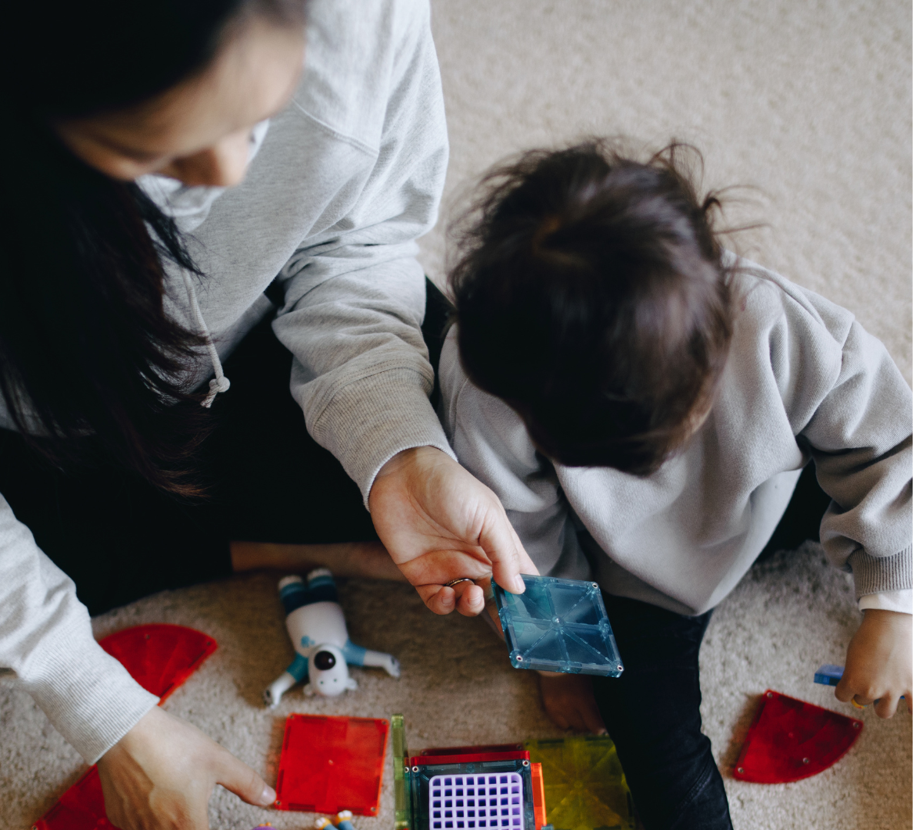
In Hamilton County alone, the number of
children growing up in financial hardship
includes over
9,500 households
The cost of living has increased by over $11,000 for a family of 4
with 2 children in childcare
OUR COMMUNITY IS CALLING ON YOU
Notes:
We know these neighbors are not alone in their experiences
There are thousands of families experiencing similar hardship
In Hamilton County alone, there are over 9,500 households with children growing up in financial hardship
These households include families living in poverty and families struggling to afford basic needs in this uncertain economy
Also known as ALICE households
Asset Limited – Income Constrained – Employed
ALICE Families often work two or three jobs and are forced to make impossible choices each day
These parents and caregivers are our neighbors and co-workers
These children are the future of our community and our workforce
And the need has never been greater for these families
The cost of living from 2021 to 2022 increased by over $11,000 for a family of four with two children in childcare
The hard truth is, these households are facing even greater challenges compared to the rest of the country
91% of counties in the country outpaced Hamilton County in fostering upward economic mobility for children born into low-income families
What does that mean?
It means children growing up in our community can’t break the generational cycle of financial hardship alone
These families want what all parents want, what many in this room want for our own children, the best for our children
Your support for United Way can help them reach these dreams

Slide 6
CONNECTING OUR COMMUNITY
Your support helps to ensure every child can thrive,
and families can break the cycle of financial hardship.
Notes:
The good news is, Chattanooga is a generous community
In fact, Hamilton County is in the top 25% of fastest growing economies in the U.S.
The challenge is – ensuring those resources go to children and families living in financial hardship
That's where we come in
As a community connecter, United Way puts your donation to work where it matters most
Our big idea to tackle this complex challenge?
Uniting our community with a shared vision for the future, one where every child can thrive, and families can break the cycle of financial hardship.

Slide 7
Guiding local leaders in United for Working Families to offer benefits like flexibility and childcare support
Answering over 73,000 211 requests and providing over $800,000 in emergency assistance
Empowering over 70 nonprofits with over $4M through our inclusive grant model
YOUR SUPPORT
UPLIFTS OUR NEIGHBORS
Notes:
Your role in this work is critical
In fact, you’re at the center of empowering real change for our neighbors
We know the power of community, when we work together, we can achieve so much more
Your donation to United Way is no exception
Your dollar works harder when it’s working together with those of other donors
Your donation empowers us to
Answer more 211 requests, connecting neighbors to food, housing, employment, and more
Empower more local employers with the data and tools they need to offer family-friendly benefits
Support more local nonprofits with grant funding and collaborative programing to serve more neighbors
Together, we can create lasting change for neighbors like Sarah, Marcus, and Tasha
[Optional - depending on audience]
It takes an average of $572 to help keep a family in their home for a month through 211 direct assistance.
If you get paid every two weeks, that's just $22 per paycheck. Your $22 per paycheck goes directly to helping keep families in their home.

Slide 8
JOIN US!
Give Help
Visit unitedwaycha.org/get-involved
Get Help
Call 211 or visit unitedwaycha.org/211
Notes:
My ask to you today is simple - JOIN US
Join us in this important work in uplifting our neighbors so every child, and every family can thrive, not just survive

